Slide 1
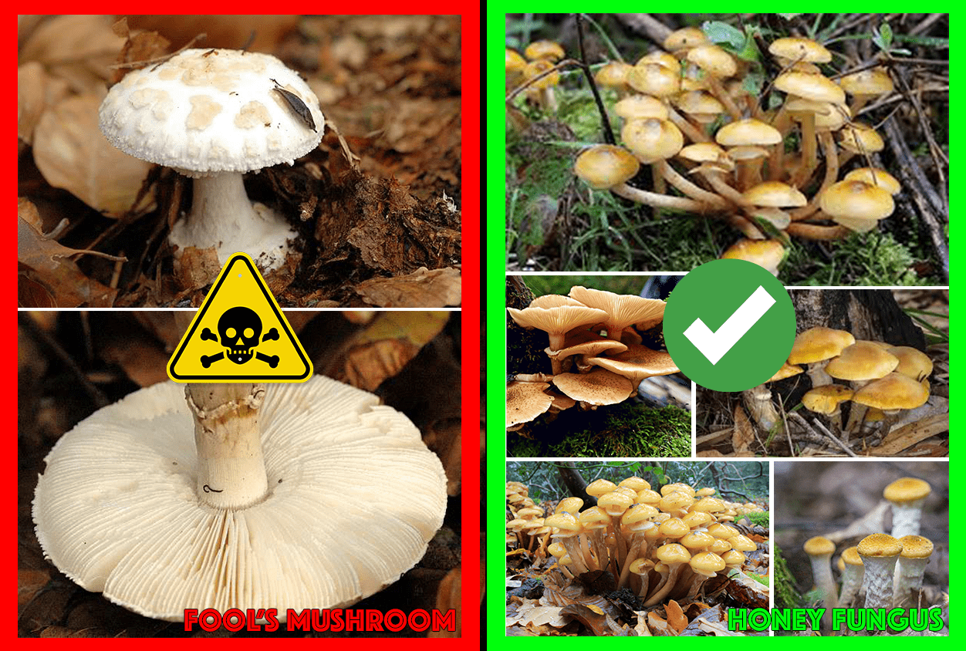
mushroom!
(Classifying Mushrooms as Edible or Poisonous)
arya bharath and james wright

Slide 2
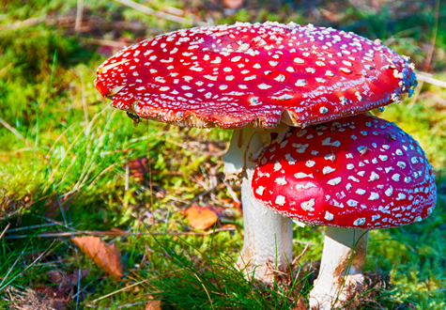

Background/Goal
Real world implications
Most people will not be able to identify whether something is definitively poisonous or not based on looking at it alone
What is the optimal method for classifying?
Possible to create a very simple set of rules that humans can understand and use
Would lose a lot of precision that would result in worse results over time
Useful to use a machine learning model to classify instead
Classify mushrooms poisonous or edible
20 attributes

Slide 3
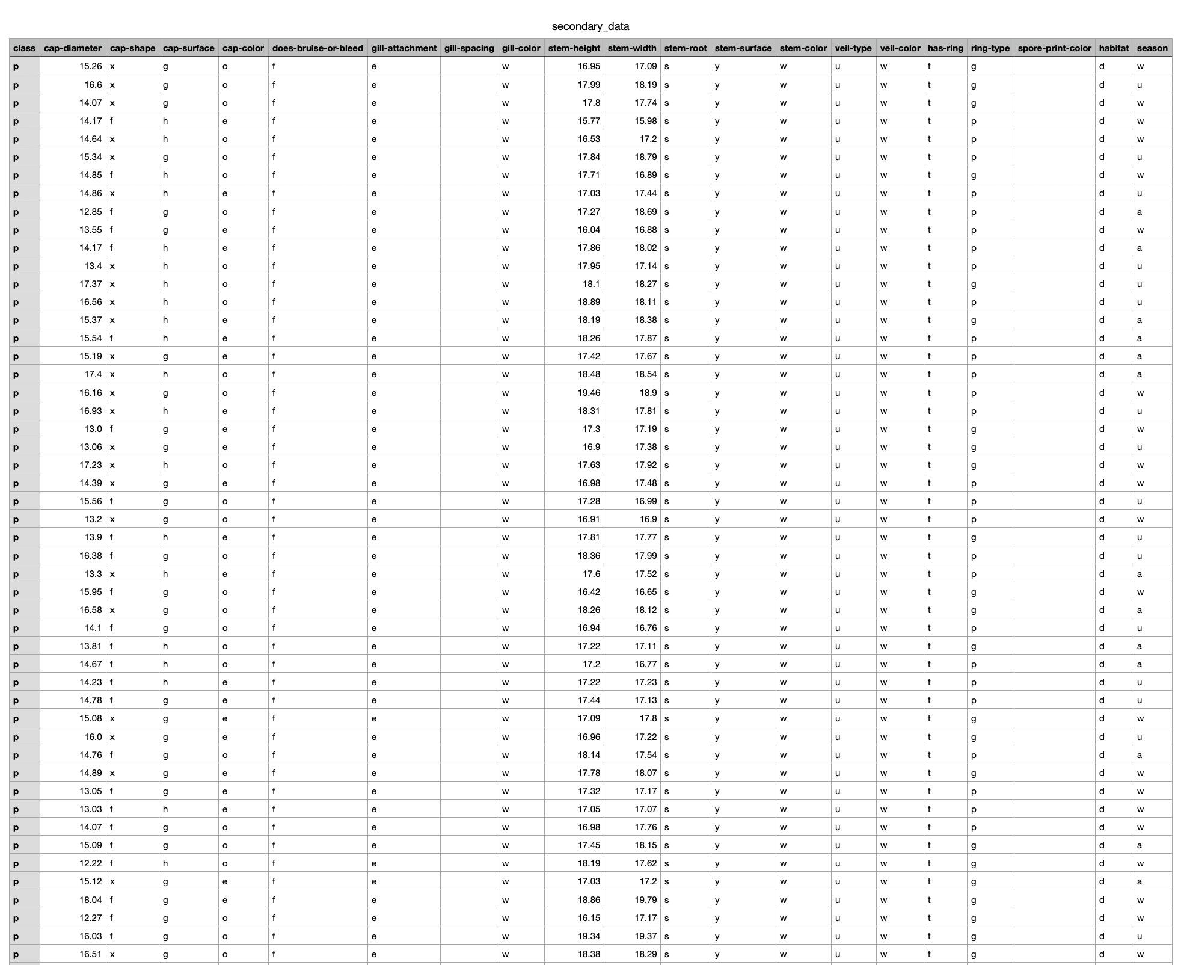
Dataset
UCI Repository
61,069 instances
Dimensionality of 20
307,463 missing values total
Concentrated in only a few specific columns
How to deal with missing values?
If we replace with mean/mode, it is possible that our filled values make results worse (maybe only certain types of mushrooms had values for certain attributes, which could skew our results)
Also possible to use WEKA placeholder missing values
Is no information better than potentially bad information?
Class distribution
33,888 poisonous (55.5%)
27,181 edible (44.5%)
Unbalanced dataset

Slide 4
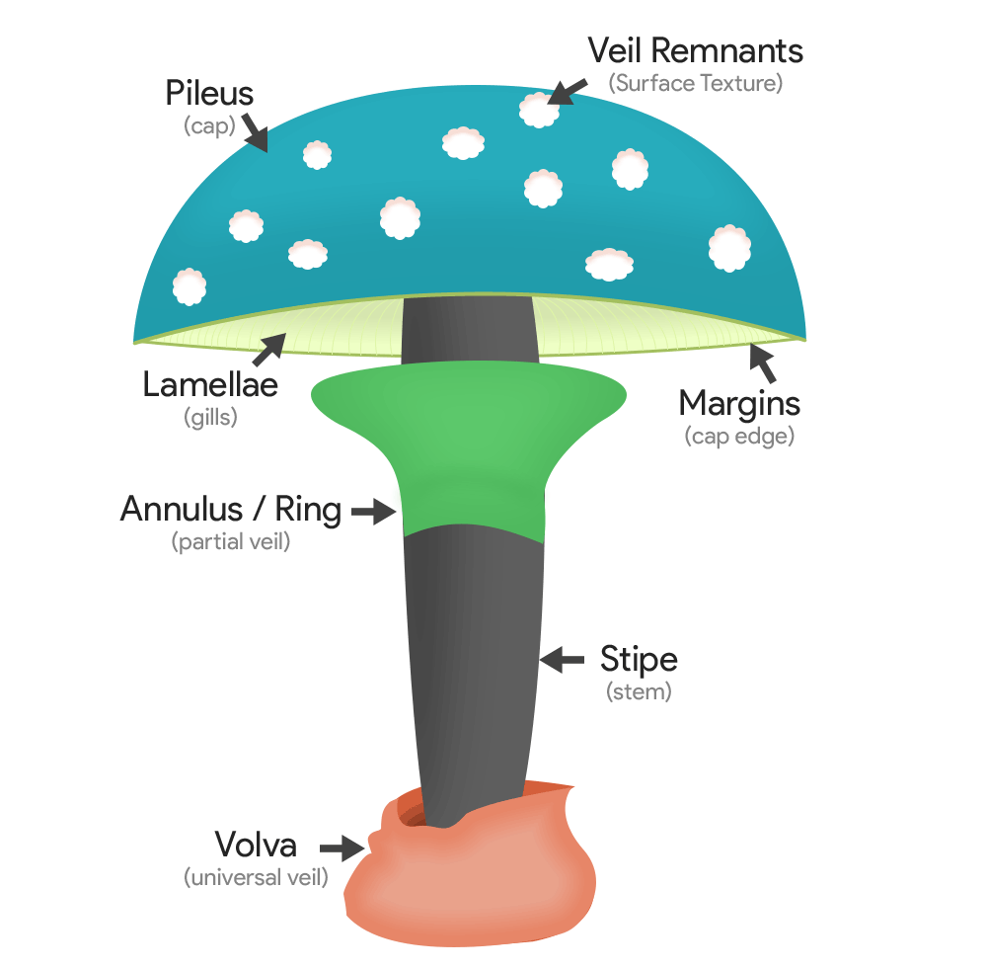
Attributes
cap-diameter: quantitative continuous, given as a float in centimeters (cm)
cap-shape: qualitative nominal, given as bell (b), conical (c), convex (x), flat (f), sunken (s), spherical (p), or others (o)
cap-surface: qualitative nominal, given as fibrous (i), grooves (g), scaly (y), smooth (s), shiny (h), leathery (l), silky (k), sticky (t), wrinkled (w), or fleshy (e)
cap-color: qualitative nominal, given as brown (n), buff (b), gray (g), green (r), pink (p), purple (u), red (e), white (w), yellow (y), blue (l), orange (o), or black (k)
does-bruise-bleed: qualitative nominal, given as bruises-or-bleeding (t) or no (f)
gill-attachment: qualitative nominal, given as adnate (a), adnexed (x), decurrent (d), free (e), sinuate (s), pores (p), none (f), or unknown (?)
gill-spacing: quantitative continuous, given as a float in centimeters (cm)
gill-color: qualitative nominal, given as brown (n), buff (b), gray (g), green (r), pink (p), purple (u), red (e), white (w), yellow (y), blue (l), orange (o), black (k), or none (f)
stem-height: quantitative continuous, given as a float in centimeters (cm)
stem-width: quantitative continuous, given as a float in centimeters (cm)

Slide 5
Attributes continued
stem-root: qualitative nominal, given as bulbous (b), swollen (s), club (c), cup (u), equal (e), rhizomorphs (z), or rooted (r)
stem-surface: qualitative nominal, given as fibrous (i), grooves (g), scaly (y), smooth (s), shiny (h), leathery (l), silky (k), sticky (t), wrinkled (w), fleshy (e), or none (f)
stem-color: qualitative nominal, given as brown (n), buff (b), gray (g), green (r), pink (p), purple (u), red (e), white (w), yellow (y), blue (l), orange (o), black (k), or none (f)
veil-type: qualitative nominal, given as partial (p) or universal (u)
veil-color: qualitative nominal, given as brown (n), buff (b), gray (g), green (r), pink (p), purple (u), red (e), white (w), yellow (y), blue (l), orange (o), black (k), or none (f)
has-ring: qualitative nominal, given as ring (t) or none (f)
ring-type: qualitative nominal, given as cobwebby (c), evanescent (e), flaring (r), grooved (g), large (l), pendant (p), sheathing (s), zone (z), scaly (y), movable (m), none (f), or unknown (?)
spore-print-color: qualitative nominal, given as brown (n), buff (b), gray (g), green (r), pink (p), purple (u), red (e), white (w), yellow (y), blue (l), orange (o), or black (k)
habitat: qualitative nominal, given as grasses (g), leaves (l), meadows (m), paths (p), heaths (h), urban (u), waste (w), or woods (d)
season: qualitative nominal, given as spring (s), summer (u), autumn (a), or winter (w)

Slide 6
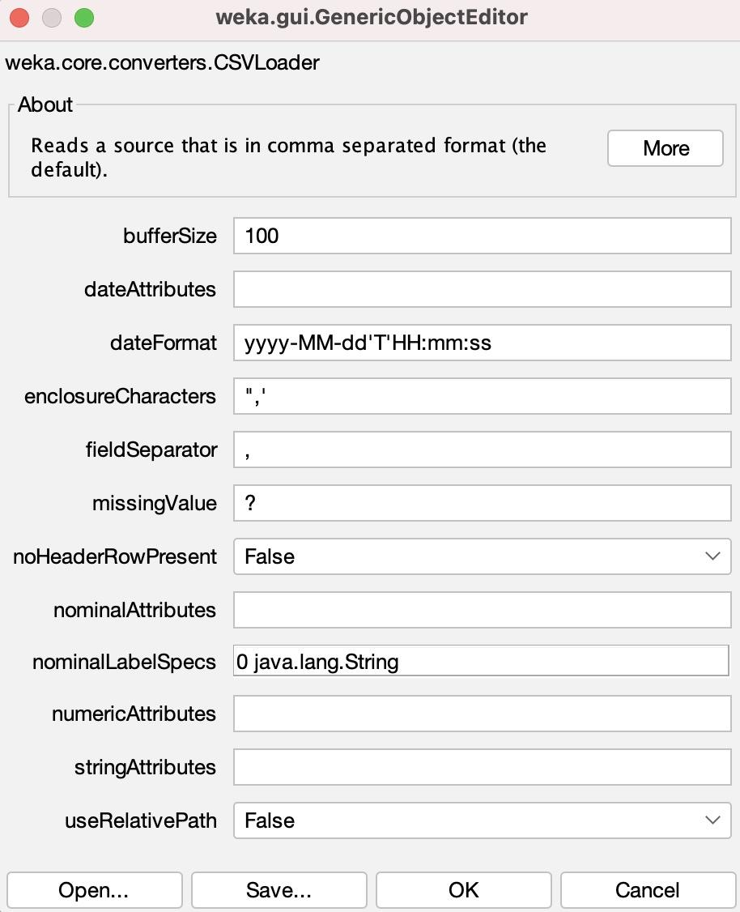
Preprocessing
2 approaches for missing values
Replaced with “?” using WEKA
Default missingValue for WEKA, we wanted to explore how this interacted
Mean/mode
Fixed issue with dataset not loading in WEKA with GenericObjectEditor window
WEKA assumes .csv files have values separated by commas, but our values had semicolons
Edited fieldSeparator value
Class variable was originally set to the last attribute in the file (habitat)
No normalization necessary
All quantitative attributes (those with width, height, etc.) were relatively small and were confined to the same ranges of values
No derived attributes

Slide 7
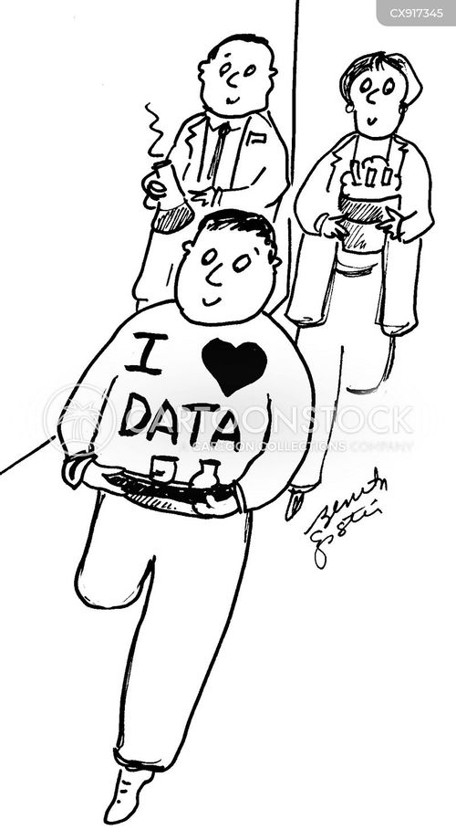
Train/Validation/Test Split
To split our dataset into training, validation, and testing sets, we used a Python script that employed pandas, sklearn, scipy.io, and the arff libraries
Used the stratify parameter to ensure that the training, validation, and testing datasets would all maintain the same proportions between class labels
For our data, the ratio between p (poisonous) to e (edible) instances was around 1.25, so all of the split datasets would also need to have this ratio
70:15:15 split between the training, validation, and testing datasets
42,672 instances, 9174 instances, and 9175 instances respectively

Slide 8
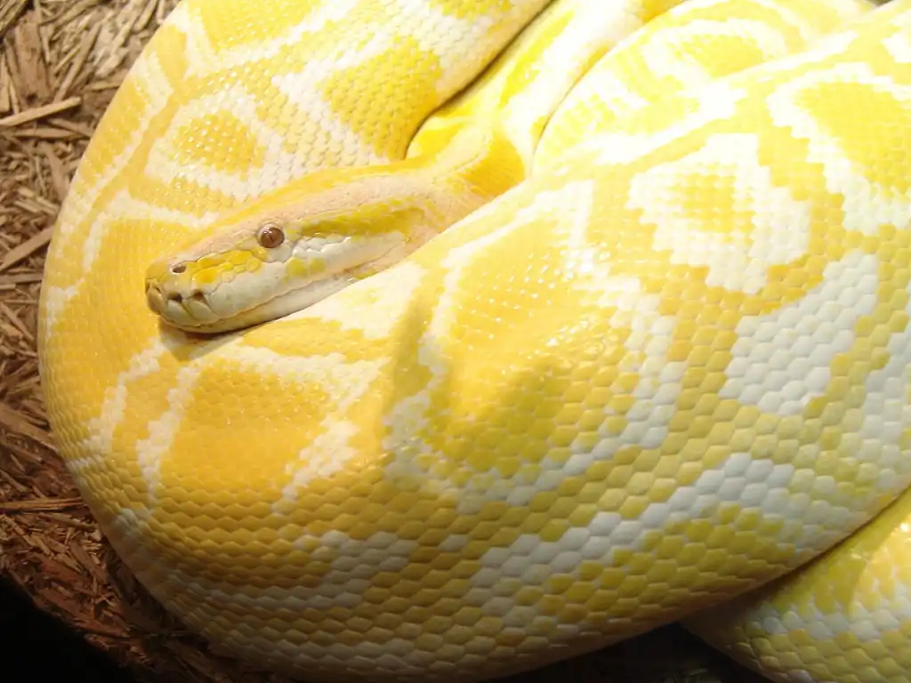
Python Script
import pandas as pd
from sklearn.model_selection import train_test_split
from scipy.io import arff
import arff as liac_arff
data, meta = arff.loadarff('data.arff')
df = pd.DataFrame(data)
def decode_bytes(df):
for col in df.select_dtypes([object]):
df[col] = df[col].apply(lambda x: x.decode('utf-8') if isinstance(x, bytes) else x)
return df
df = decode_bytes(df)
X = df.iloc[:, :-1]
y = df.iloc[:, -1]
X_train, X_temp, y_train, y_temp = train_test_split(X, y, test_size=0.3, stratify=y, random_state=42)
X_val, X_test, y_val, y_test = train_test_split(X_temp, y_temp, test_size=0.5, stratify=y_temp, random_state=42)
train_set = pd.concat([y_train, X_train], axis=1)
val_set = pd.concat([y_val, X_val], axis=1)
test_set = pd.concat([y_test, X_test], axis=1)
def save_to_arff(df, filename, meta):
arff_data = {
'description': '',
'relation': 'dataset',
'attributes': [(name, list(df[name].unique())) if df[name].dtype == 'object' else (name, 'REAL') for name in df.columns],
'data': df.values.tolist()
}
with open(filename, 'w') as f:
liac_arff.dump(arff_data, f)
save_to_arff(train_set, 'train_set.arff', meta)
save_to_arff(val_set, 'val_set.arff', meta)
save_to_arff(test_set, 'test_set.arff', meta)

Slide 9

Attribute Selection
CfsSubsetEval
Uses a combination of the individual predicting power of each attribute and the redundancy of the predictions to select attributes
CorrelationAttributeEval
Orders attributes by using Pearson Correlation between each individual attribute and the class
InfoGainAttributeEval
Sorts attributes based on information gain/entropy loss
OneRAttributeEval
Chooses attributes with OneR Classifier (uses a ruleset based on one attribute)
Intuitive selection

Slide 10
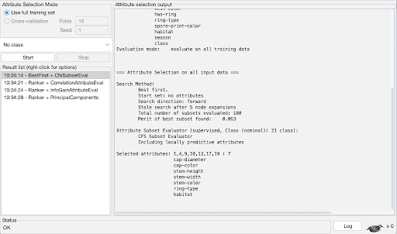
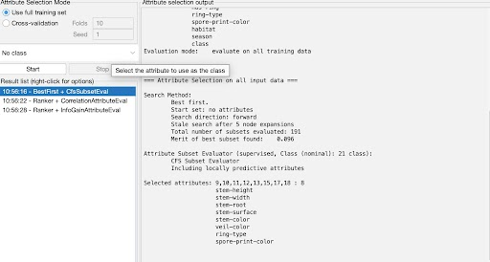
CfsSubsetEval
Missing values as “?”
Missing values as mean/mode

Slide 11
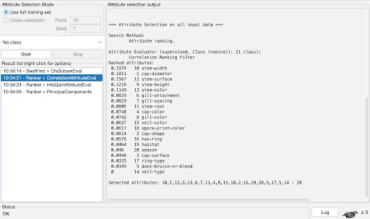

CorrelationAttributeEval
Missing values as “?” (cut-off 0.08)
Missing values as mean/mode (cut-off 0.08)

Slide 12
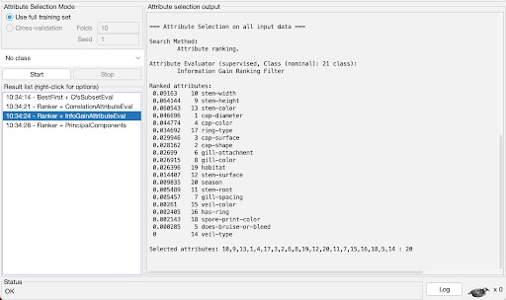
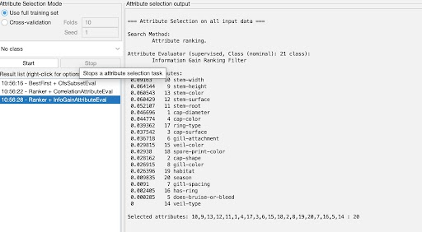
InfoGainAttributeEval
Missing values as “?” (cut-off 0.025)
Missing values as mean/mode (cut-off 0.04)

Slide 13
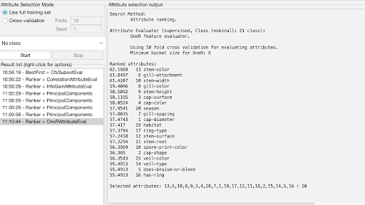
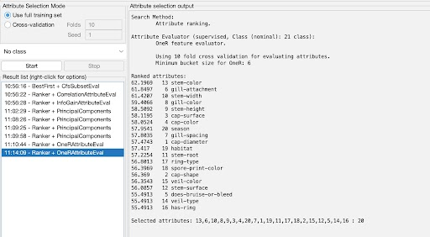
OneRAttributeEval
Missing values as “?” (cut-off 57.5)
Missing values as mean/mode (cut-off 57.5)

Slide 14

Intuitive Selection
Cap-shape
Cap-surface
Cap-color
Gill-color
Stem-surface
Stem-color
Veil-type
Veil-color
Has-ring
Ring-type
Spore-print-color
We chose these because poisonous plants and animals are usually identifiable by their shape and color, not necessarily their size
We thus removed the attributes that had to do with the measurements of the mushrooms, as well as some others like season and habitat that we thought were likely not related as much to the class

Slide 15
Common Selected Attributes
Several attributes consistently appeared in the attribute selection algorithms
Stem-width
Stem-height
Stem-color
Cap-color
Gill-attachment
Cap-diameter
We did our intuitive selection based on what made the most logical sense to us, but maybe the performance of the intuitive models would be better if these attributes were chosen instead
Can also run additional attribute selection algorithms on WEKA to more confidently identify important attributes to predicting class

Slide 16
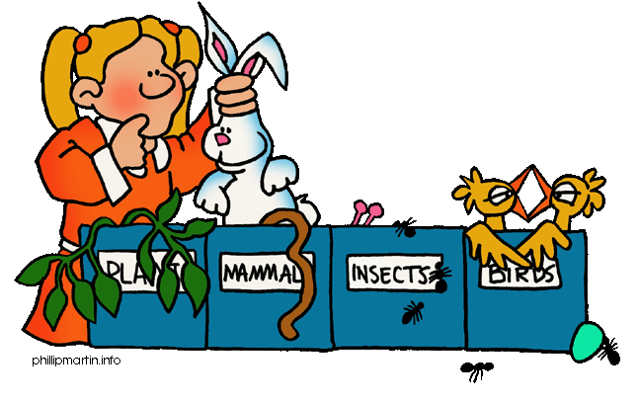
Classifiers
NaiveBayes
DecisionTable
RandomForest
J48

Slide 17
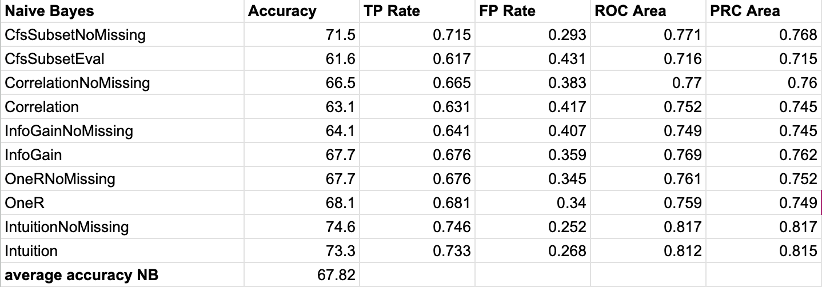
NaiveBayes
Probabilistic classifier based on Bayes’ Theorem
Assumes attributes are independent of each other
Average accuracy lower
Maybe is lower because the attributes are not actually completely independent
Discussed in later slides

Slide 18
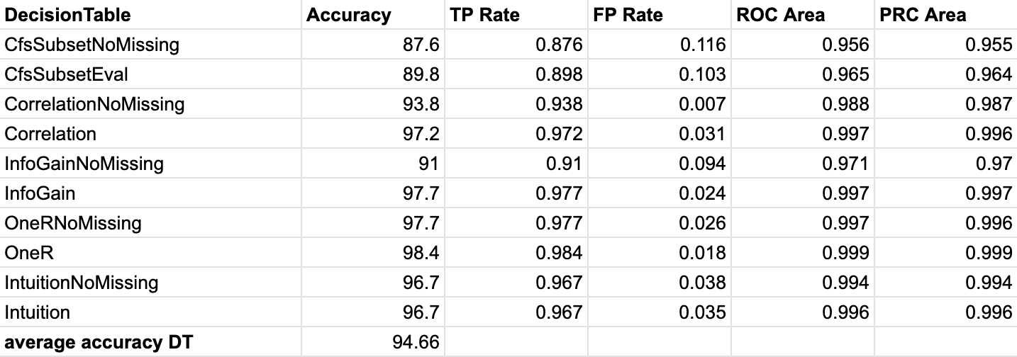
DecisionTable
ML classifier using a table based on attributes/conditions
When new data point introduced, algorithm evaluates attributes against conditions specified in decision table
Identifies matching rules based on evaluated conditions

Slide 19
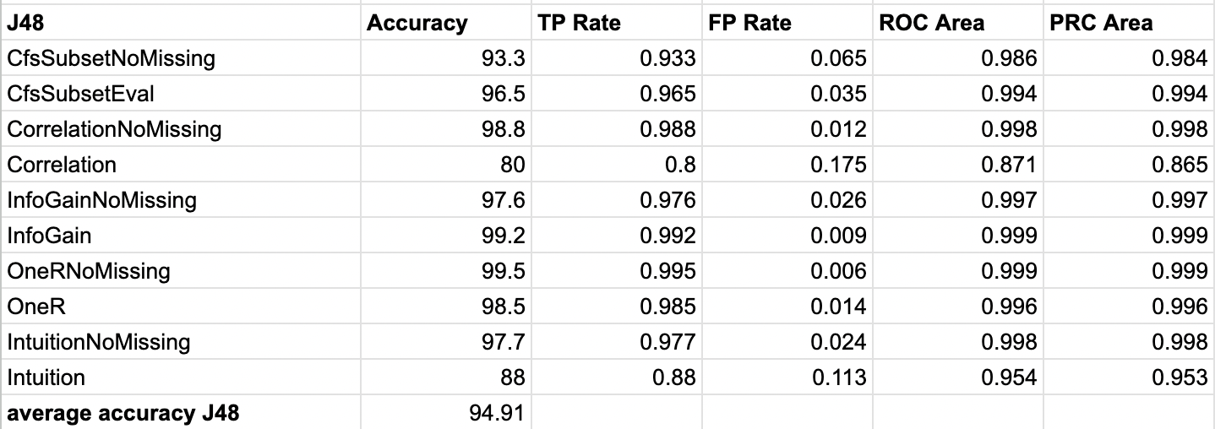
J48
Decision tree algorithm, recursively splits data into branches based on attribute values
Splits tree based on which attribute has the highest information gain (change in entropy)
Can deal with missing values
Builds tree and then uses for classification

Slide 20
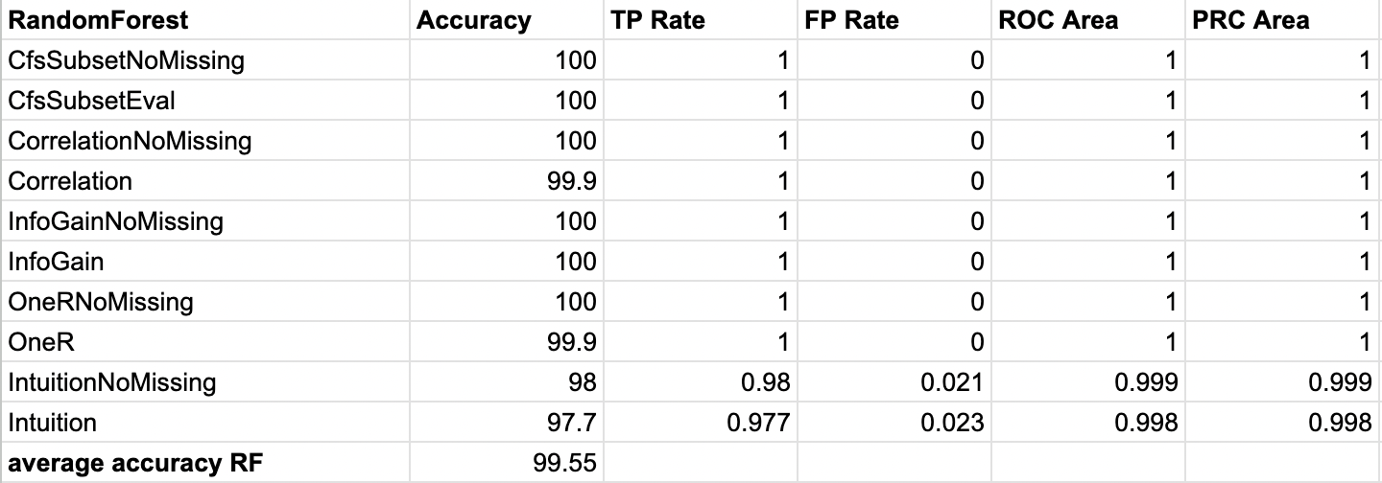
RandomForest
Combines many decision trees to produce a best result
Splits up data into random subsets
Uses each subset to produce a decision tree
Because this is a classification problem, each tree will produce a decision
Decisions are counted as votes, the classification with most votes is chosen as the output of the classifier
Many perfect results - why?

Slide 21
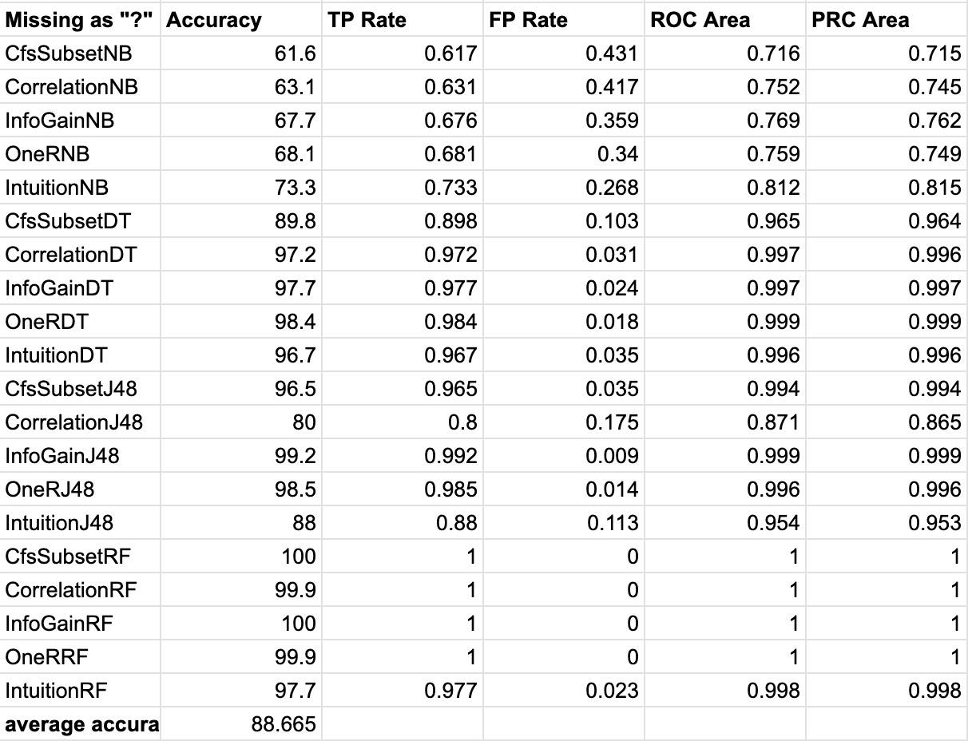
Missing as “?”

Slide 22
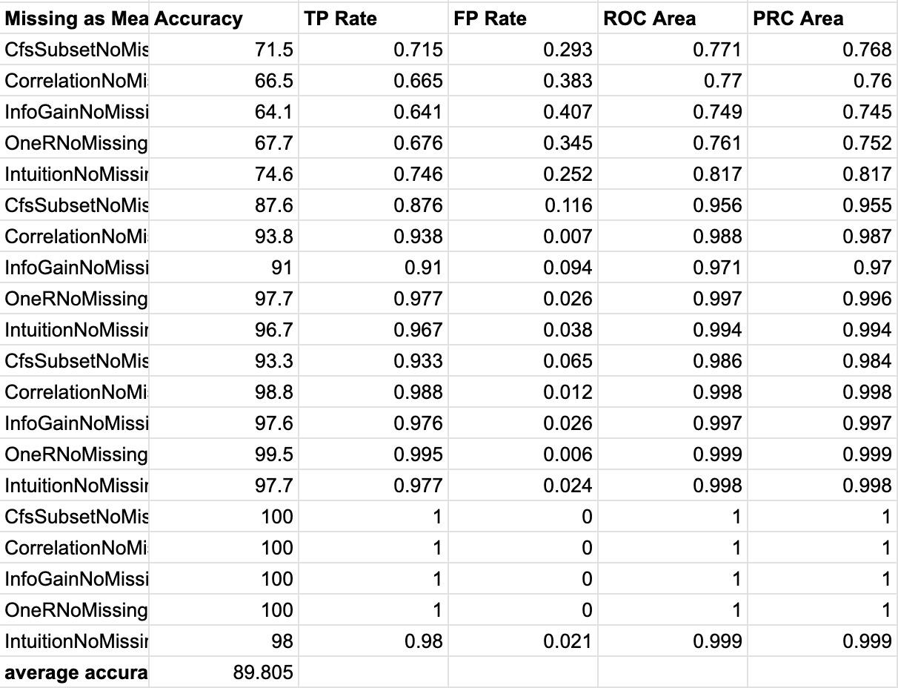
Missing as mean/mode

Slide 23
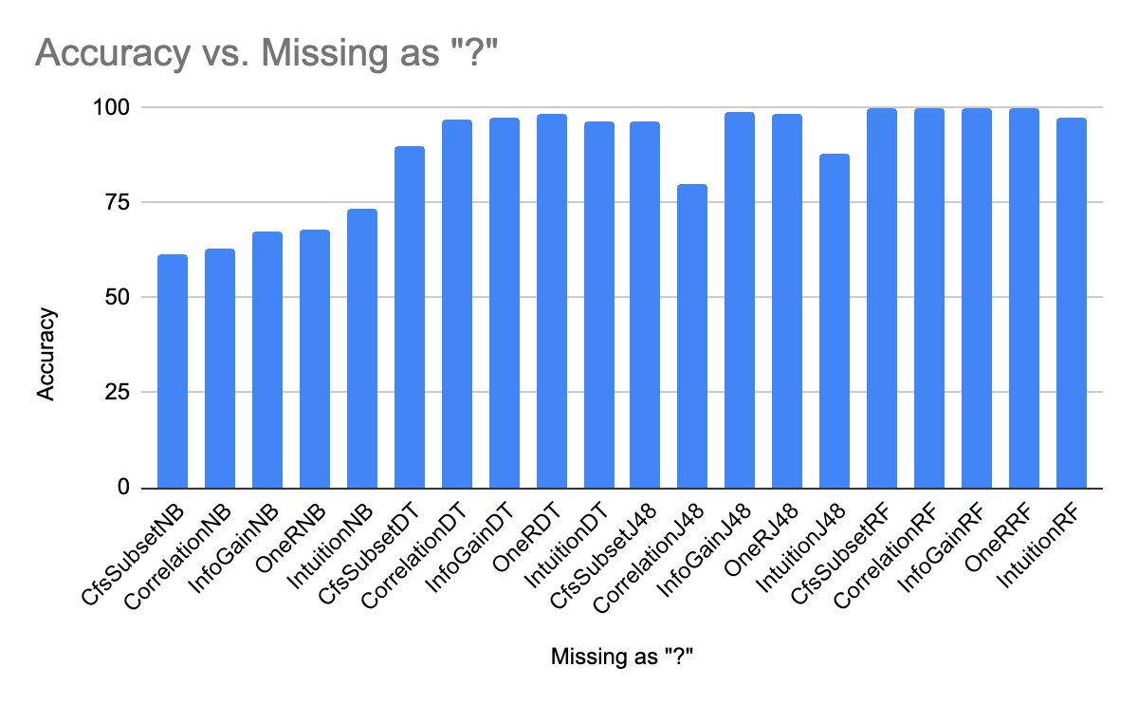
Graph slide 1

Slide 24
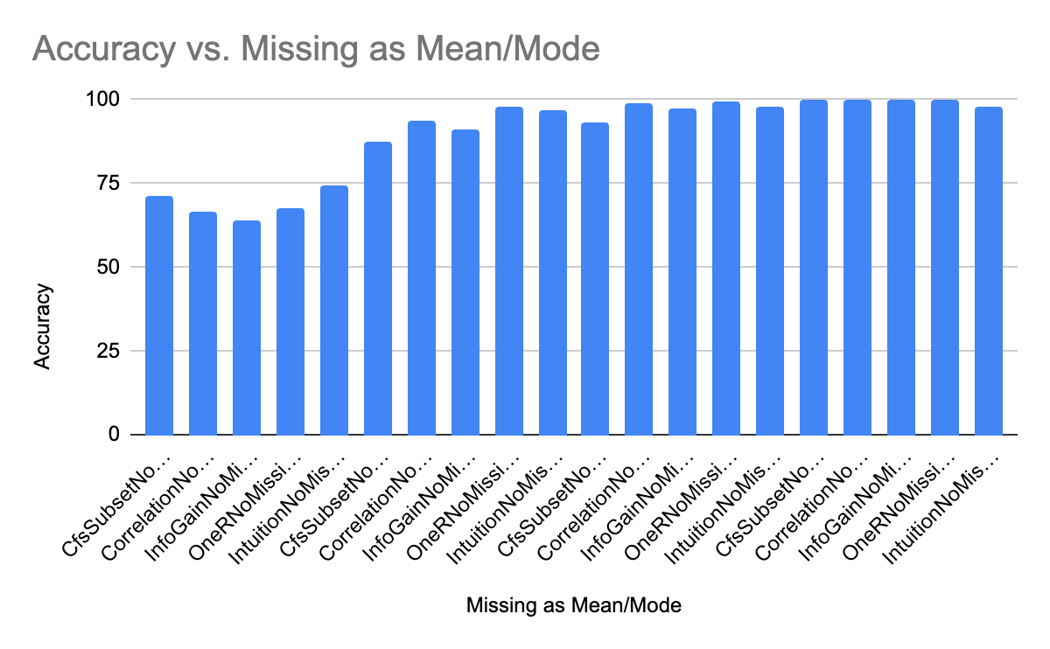
Graph slide 2

Slide 25
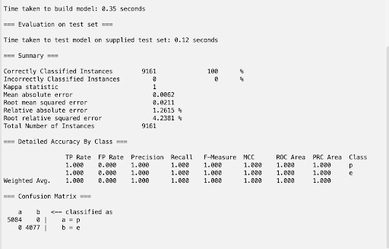
Best Model
6 models with perfect accuracy, so how to choose?
Other metrics - error loss
0.0211 root-mean-square error for best model
randomForest with OneR attribute selection
Missing values as mean/mode

Slide 26
NaiveBayes performance
NaiveBayes assumes all conditions are independent
For our datasets, clearly several attributes are dependent on each other
Quantitative attributes such as cap-diameter, stem-width, stem-height could be related
Bigger mushrooms have larger values for all 3?
Color-based attributes (stem-color, cap-color, veil-color, gill-color) potentially related
More general attributes like habitat and season are so broad that they likely correlate with many of the attributes
How to improve accuracy?
With this condition in mind, maybe it is better to evaluate the relationship between attributes to decrease correlation instead of relating them to the class variable
Could this improve model strength?
In contrast, all other 3 algorithms are based on decision tree algorithms, which can identify relationships between attributes
J48, DecisionTable, RandomForest all performed very well
Could potentially indicate that many attributes are related

Slide 27
RandomForest performance
6 of the models we tested with RandomForest had a perfect accuracy
With 9,000+ instances in the test set, is this really possible?
RandomForest combines predictions of many decision trees
If this accuracy was on the training data, this would be a case of possible overfitting - but this is test set
What if general variations across entire dataset are small enough RandomForest algorithm can “learn” the testing data as it trains?
Also possible that class variable values (poisonous and edible) require such different values for predictions that the line between the two is obvious to a complex model like RandomForest

Slide 28
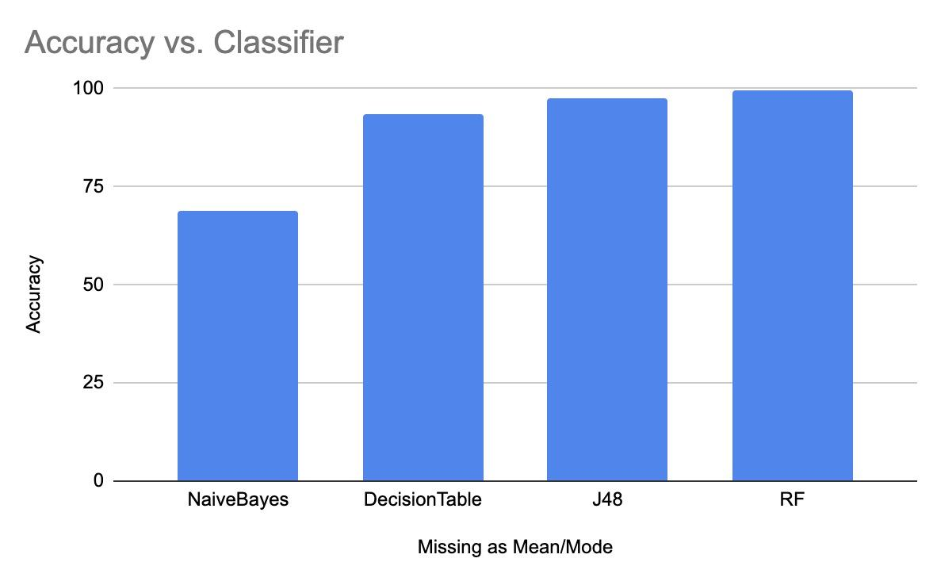
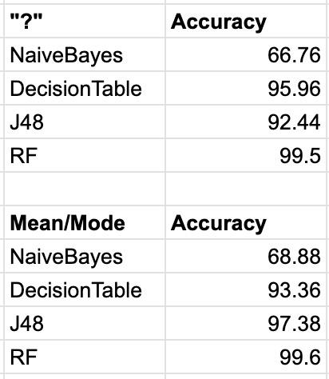
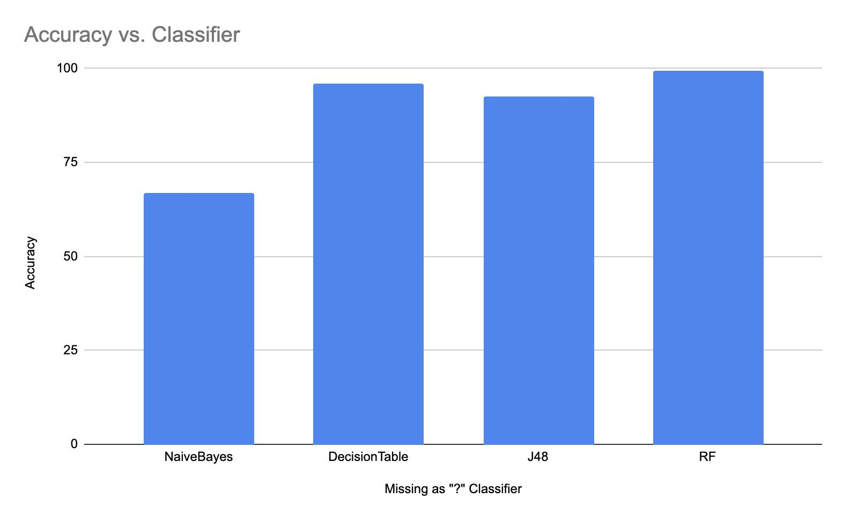
Missing values - which approach was better?
Missing values as “?”
88.67% average accuracy
Performed noticeably better for DecisionTable
Why?
Missing values as mean/mode
89.81% average accuracy
Performed noticeably better for J48
Why?
Interactions with WEKA algorithms and set missing values, but not sure

Slide 29
Discussion
We learned how to use WEKA to successfully train and test a model that classified our own selected data of poisonous vs edible mushrooms with 100% accuracy
Our dataset initially started off with 20 attributes, and our model could have possibly been improved had we not removed some of the attributes during our attribute selection step
Even with many missing values, using mean/mode was still better than assigning a specific value for missing items
Many of the attributes that were removed could have held solid predictive power of whether or not a certain mushroom is edible or poisonous
Better attribute selection could be a key improvement from our project
NaiveBayes and RandomForest performances

Slide 30
Sources
https://archive.ics.uci.edu/dataset/848/secondary+mushroom+dataset

